Slide 1
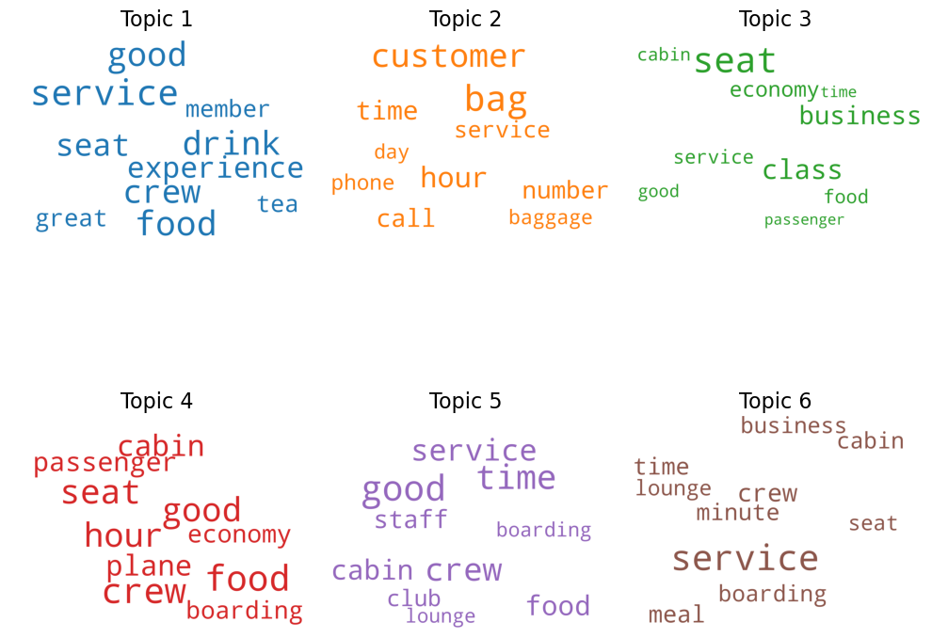
Task 1 Findings
These word clouds represent words that are commonly found within the same review suggesting some kind of association between the two words. The size of the words is proportional to the chance of that word being involved in that topic. For example, from topic 1 it is easy to draw the conclusion that it is common for passengers to have a good experience in relation to the food, drink and service from the crew. These same concepts are shown in topic 4 and 5 suggesting that a lot of the reviews are positive. Since none of the word clouds show any negative adjectives such as “poor” or “bad” it suggests that only a small minority of the reviews received were negative.
These word clouds are formed through a machine learning model which scans through all the reviews and measures the corelation between words being in the same review. The six topics on screen are the top six group of words which the model found to be in the same review as each other the most often.

